Slide 1
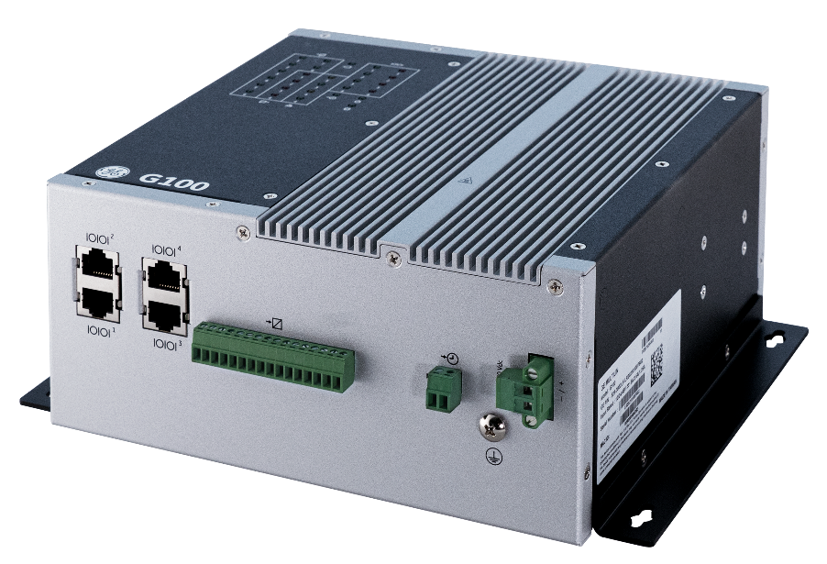
1010 - G100 HARDWARE
REV A

Slide 2
Learning & Development
Objective
Learning Module Objective
At the completion of this module you will be able to identify and recite all concepts presented.
If you are viewing this as part of a structured training program PLEASE complete the associated assessment test. You are required to score above 80%.
G100-1010 l G100 Hardware Rev A v1
SME Source Markham

Slide 3
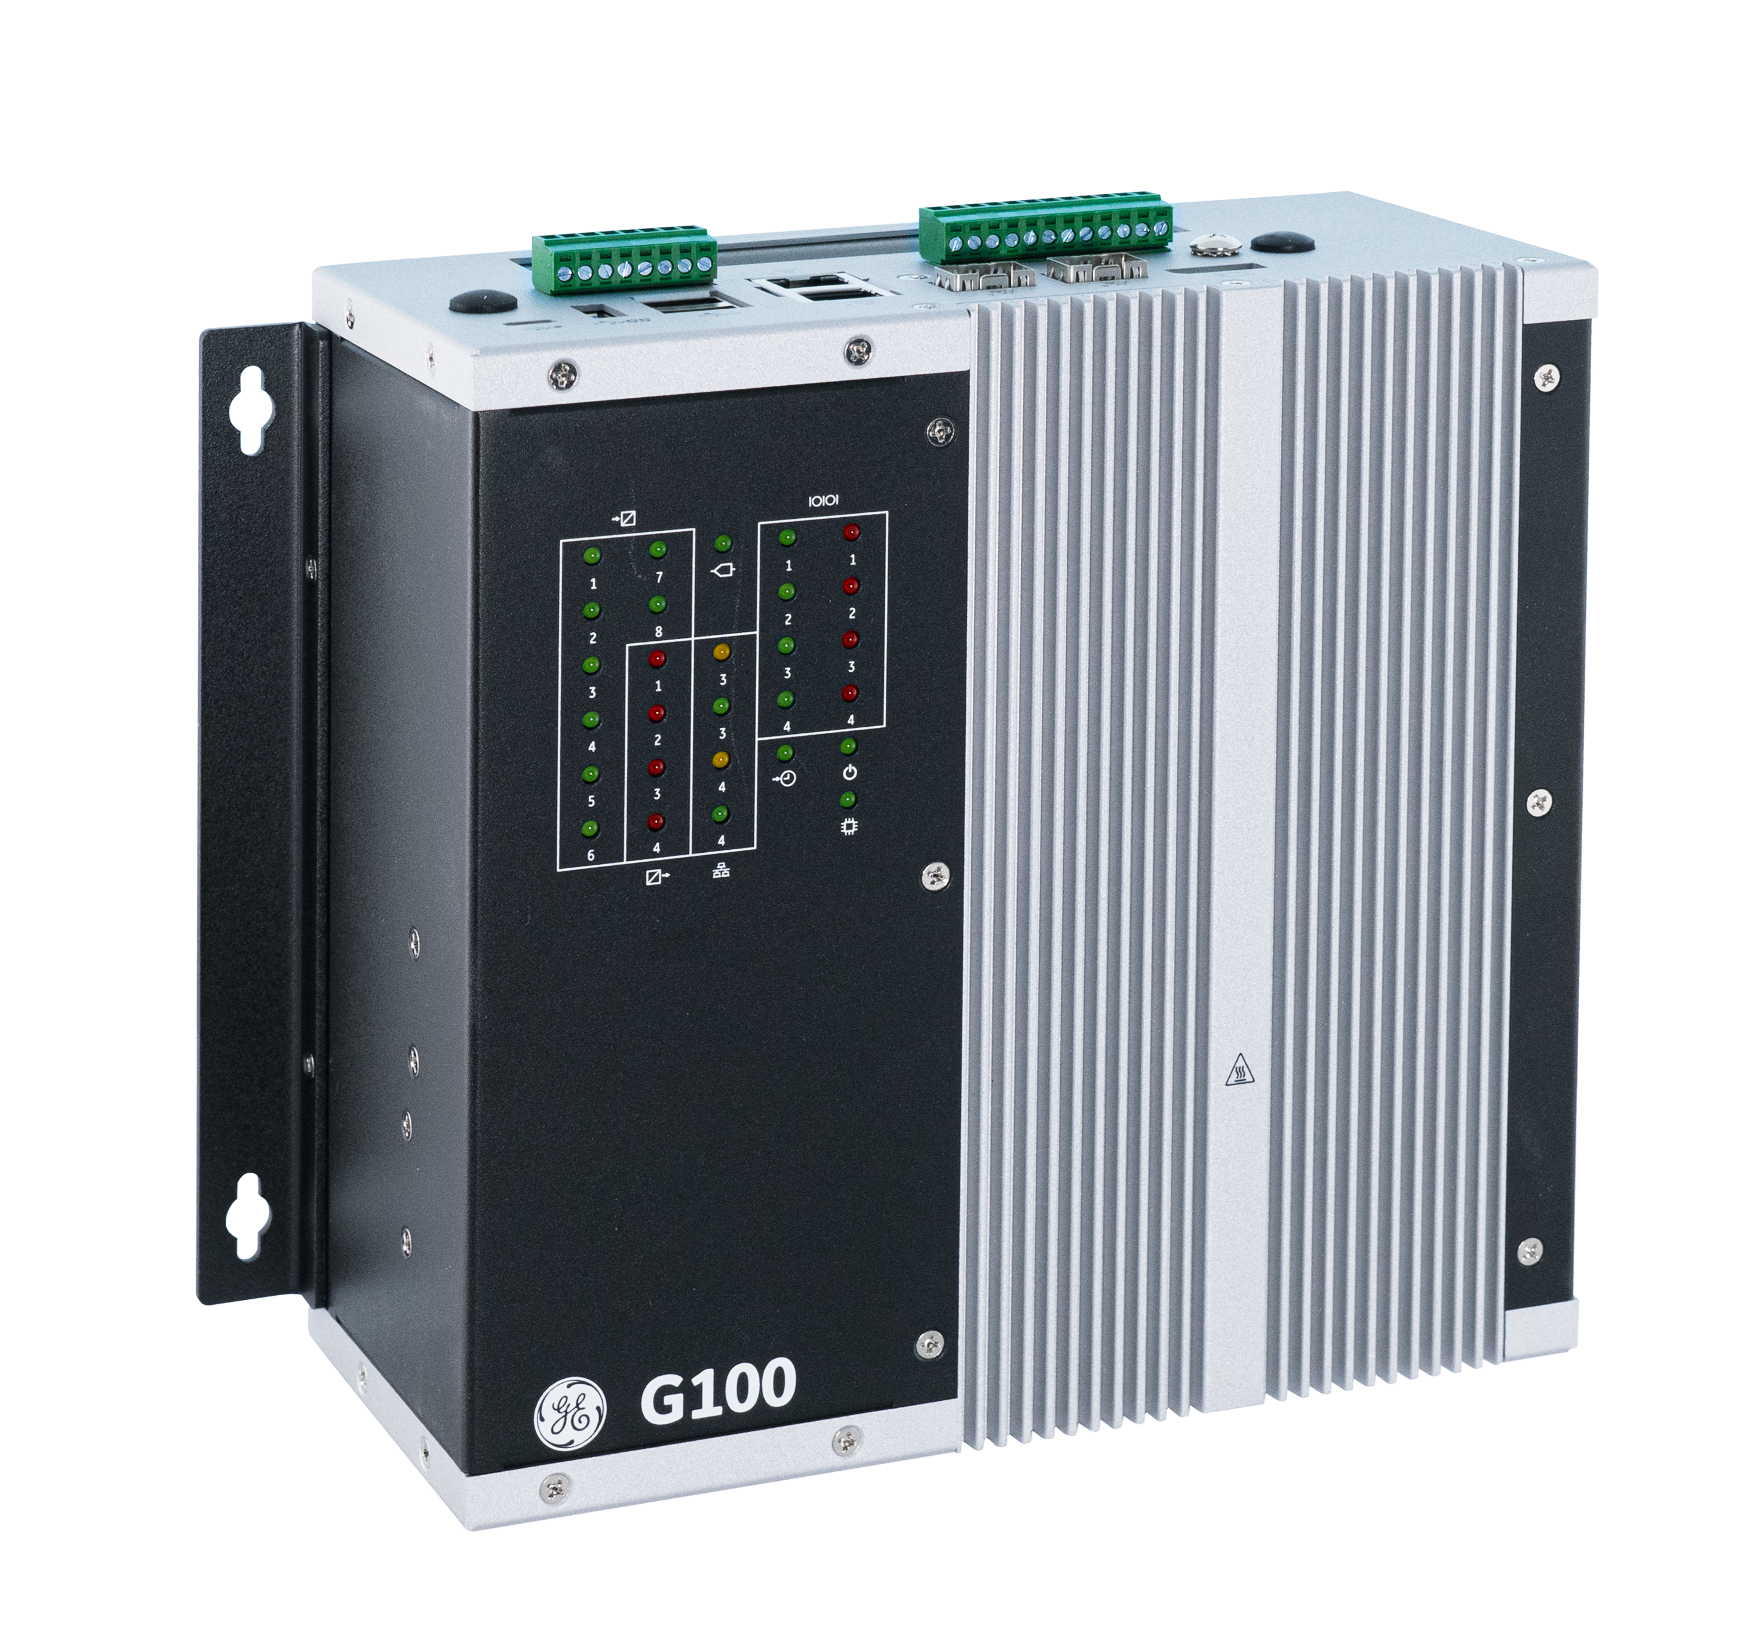
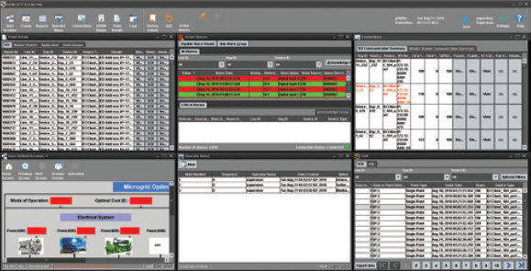
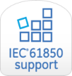
Monitor
Control
Automation
Security
Data acquisition
Automatic control
Data collection from the field devices/sensors
Interconnection with the plant DCS
Local HMI
Substation automation
Energy Management System
G100
Advanced Gateway
Data collection from substation IEDs, for control & secure monitoring
Embedded HMI
Customizable local or remote HMI with multiple windows
Advanced Automation
Automate substation procedures using IEC 61131 compliant tools
Secure Remote Access
Securely access substation device locally and remotely
Fault Recording & Data Logging , File Retrieval
Extract valuable data such as digital fault records and event files
IEC 61850
Support for IEC 61850 Edition 2 (Client) with simplified configuration
The G100 data concentrator incorporates cutting edge gateway technology with a state-of-the-art communications architecture to facilitate the smoothest combination of control, communication and monitoring in industry.
1010 – G100 Hardware
Notes:
GE’s Multilin G100 is a member of the advanced Multi-function Controller Platform (MCP). This platform offers a high-capacity, secure, future-proof, and substation-hardened set of modular and scalable hardware and software components designed to simplify deployment, operation and maintenance of automation systems for a variety of applications including:
• Centralized automation for transmission & distribution substations
• Industrial substation automation systems
• Asset performance management
• Distribution automation & microgrid
• Secure substation automation systems
• Retrofit of substation automation systems
The G100 makes it possible for a single device to host multiple functions and applications such as Supervisory Control and Data Acquisition (SCADA) Concentrator, Remote terminal Unit (RTU), Human Machine Interface, Advanced Cyber Security Features, and Non-Operational Data Storage. Consolidation of functions reduces the cost of deployment and operation while increasing system reliability through a reduced number of devices in the system.
The G100 is designed to provide a reliable and accurate collection of data (metering, status, events and faults) from serial or LAN-based intelligent substation devices to master applications such as SCADA, EMS, DMS, DCS or other enterprise applications. With its modern and robust cyber security features, the G500 is designed for smooth integration into NERC CIP and cyber security environments while consolidating functions such as Ethernet communications, time synchronization, HMI and SCADA applications.

Slide 4
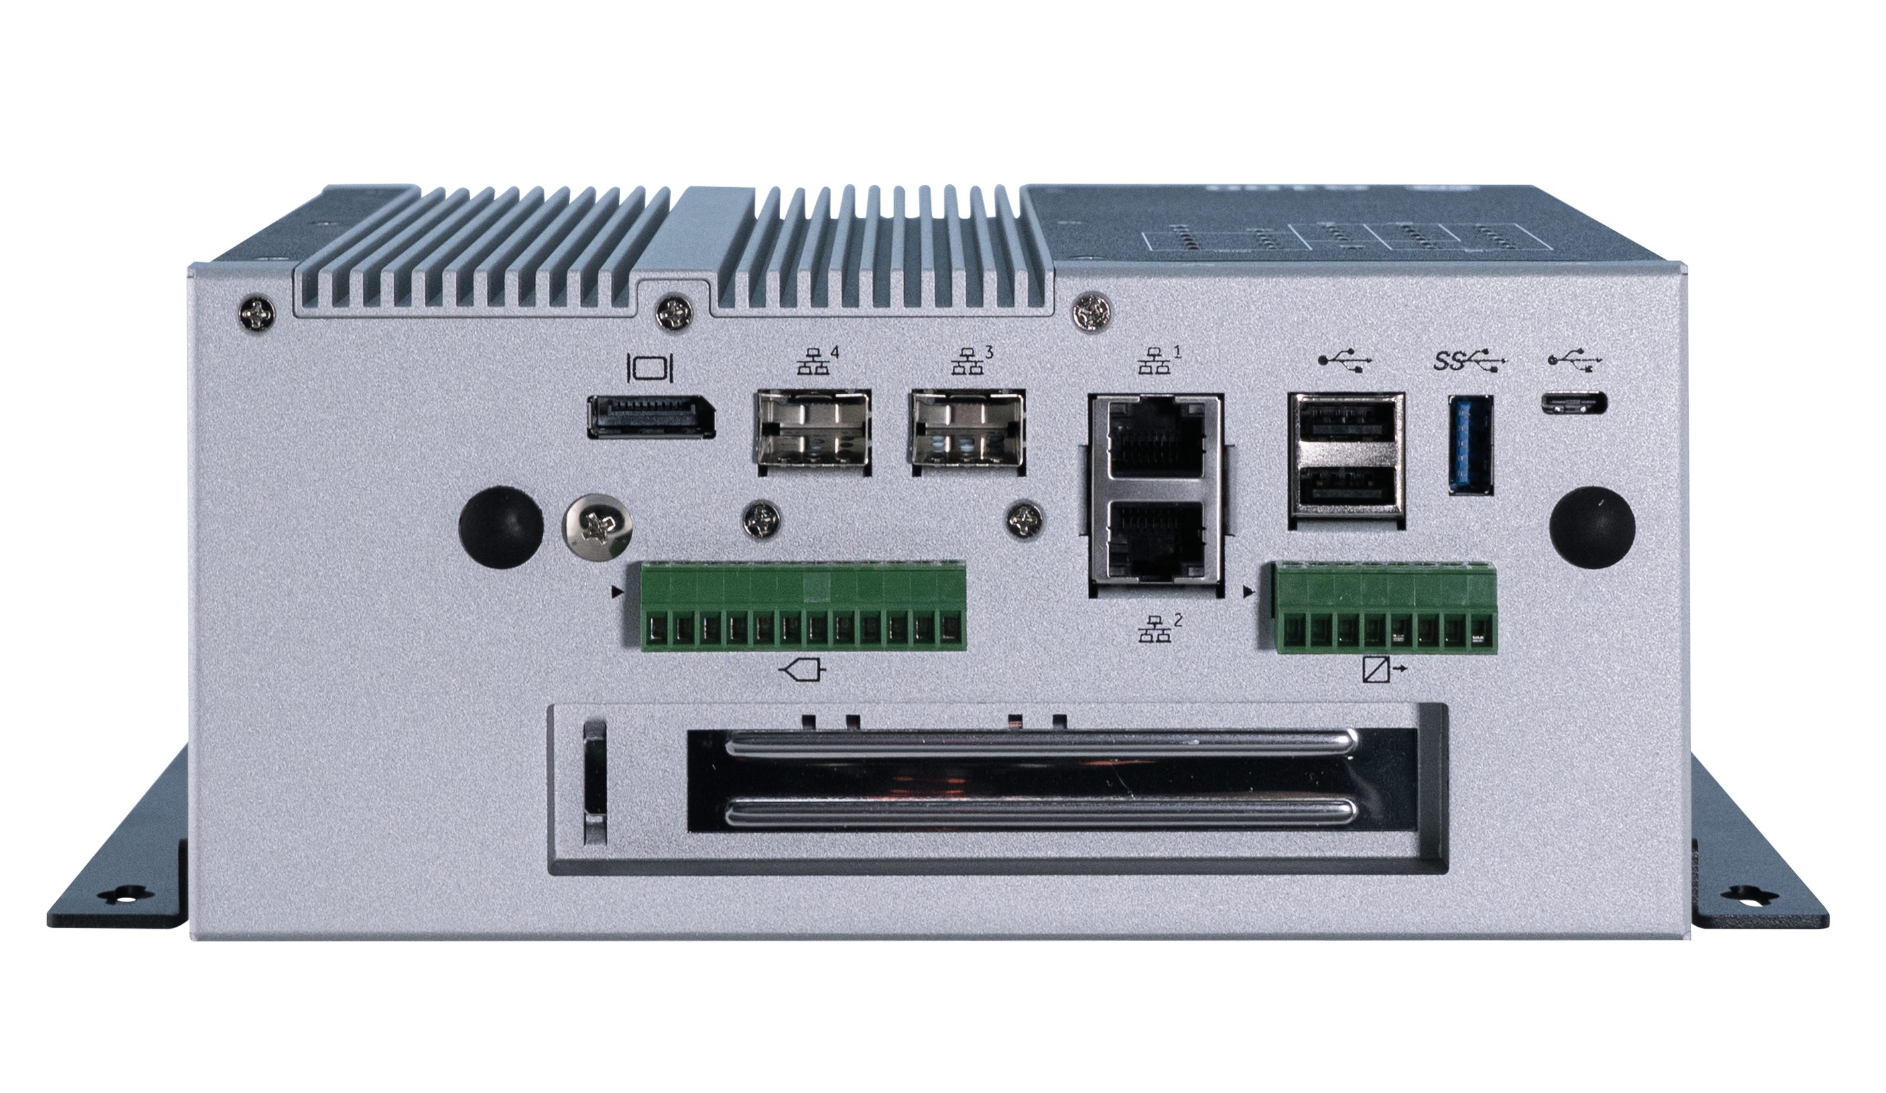
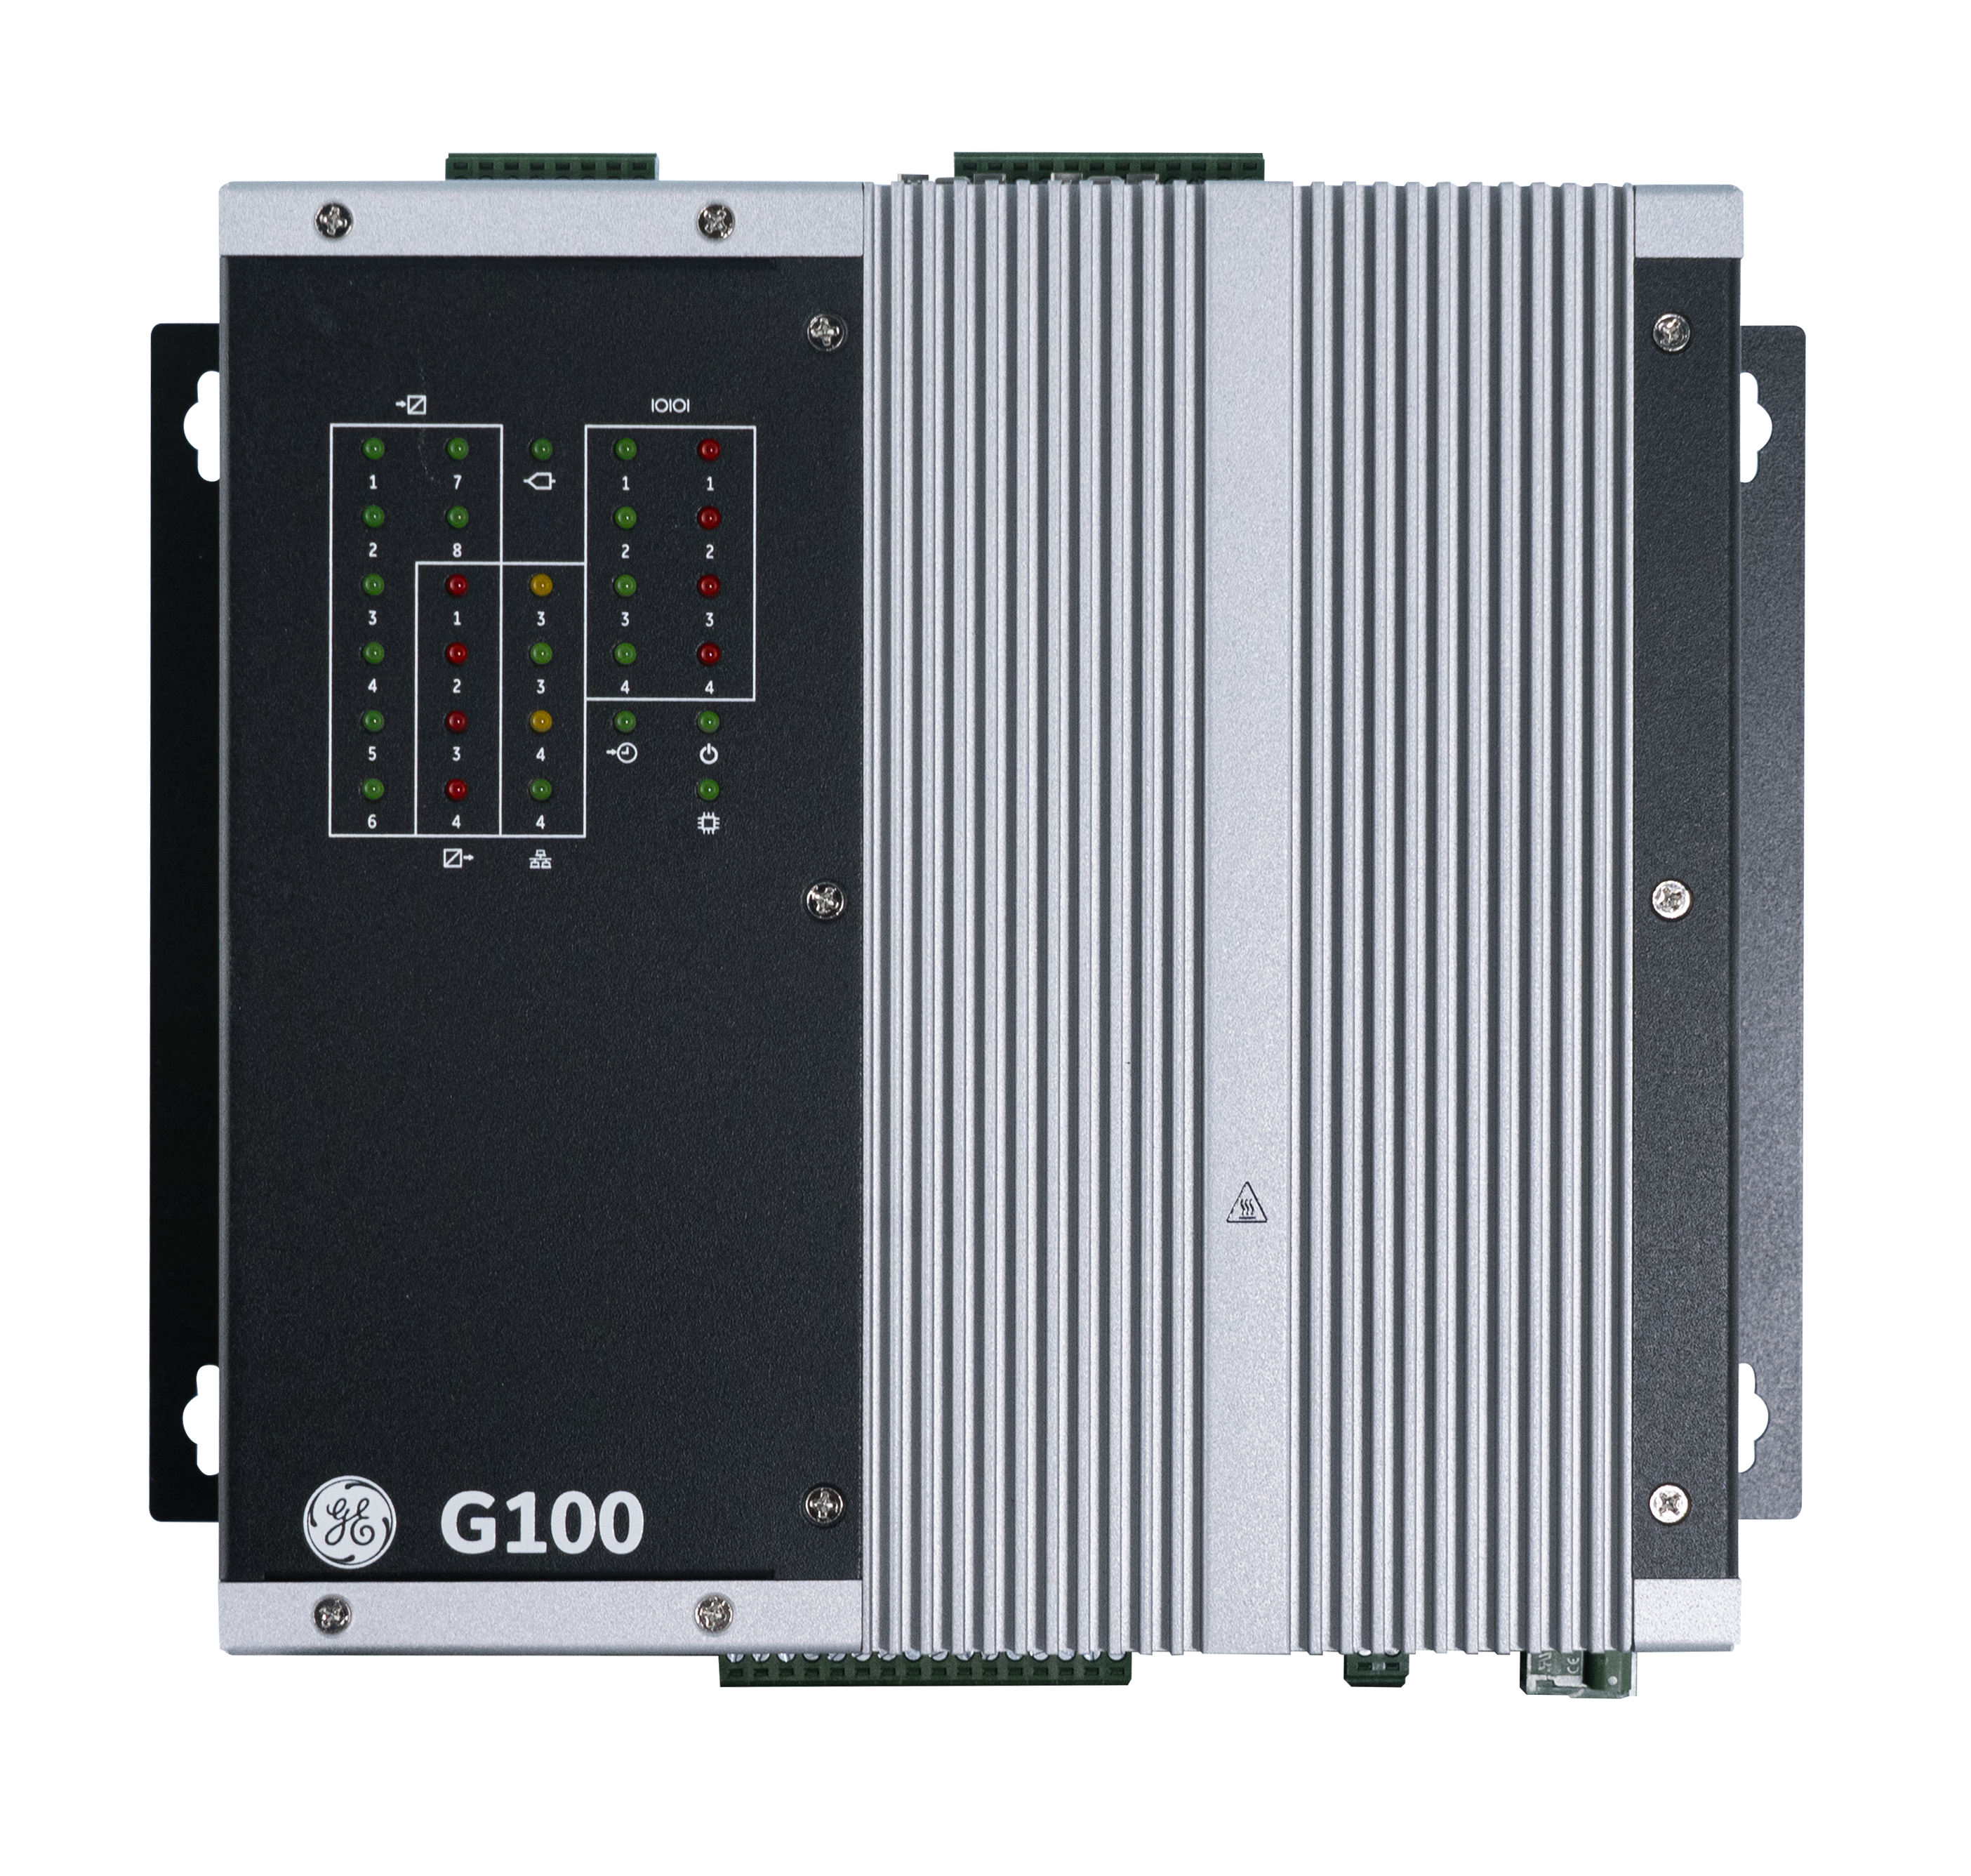
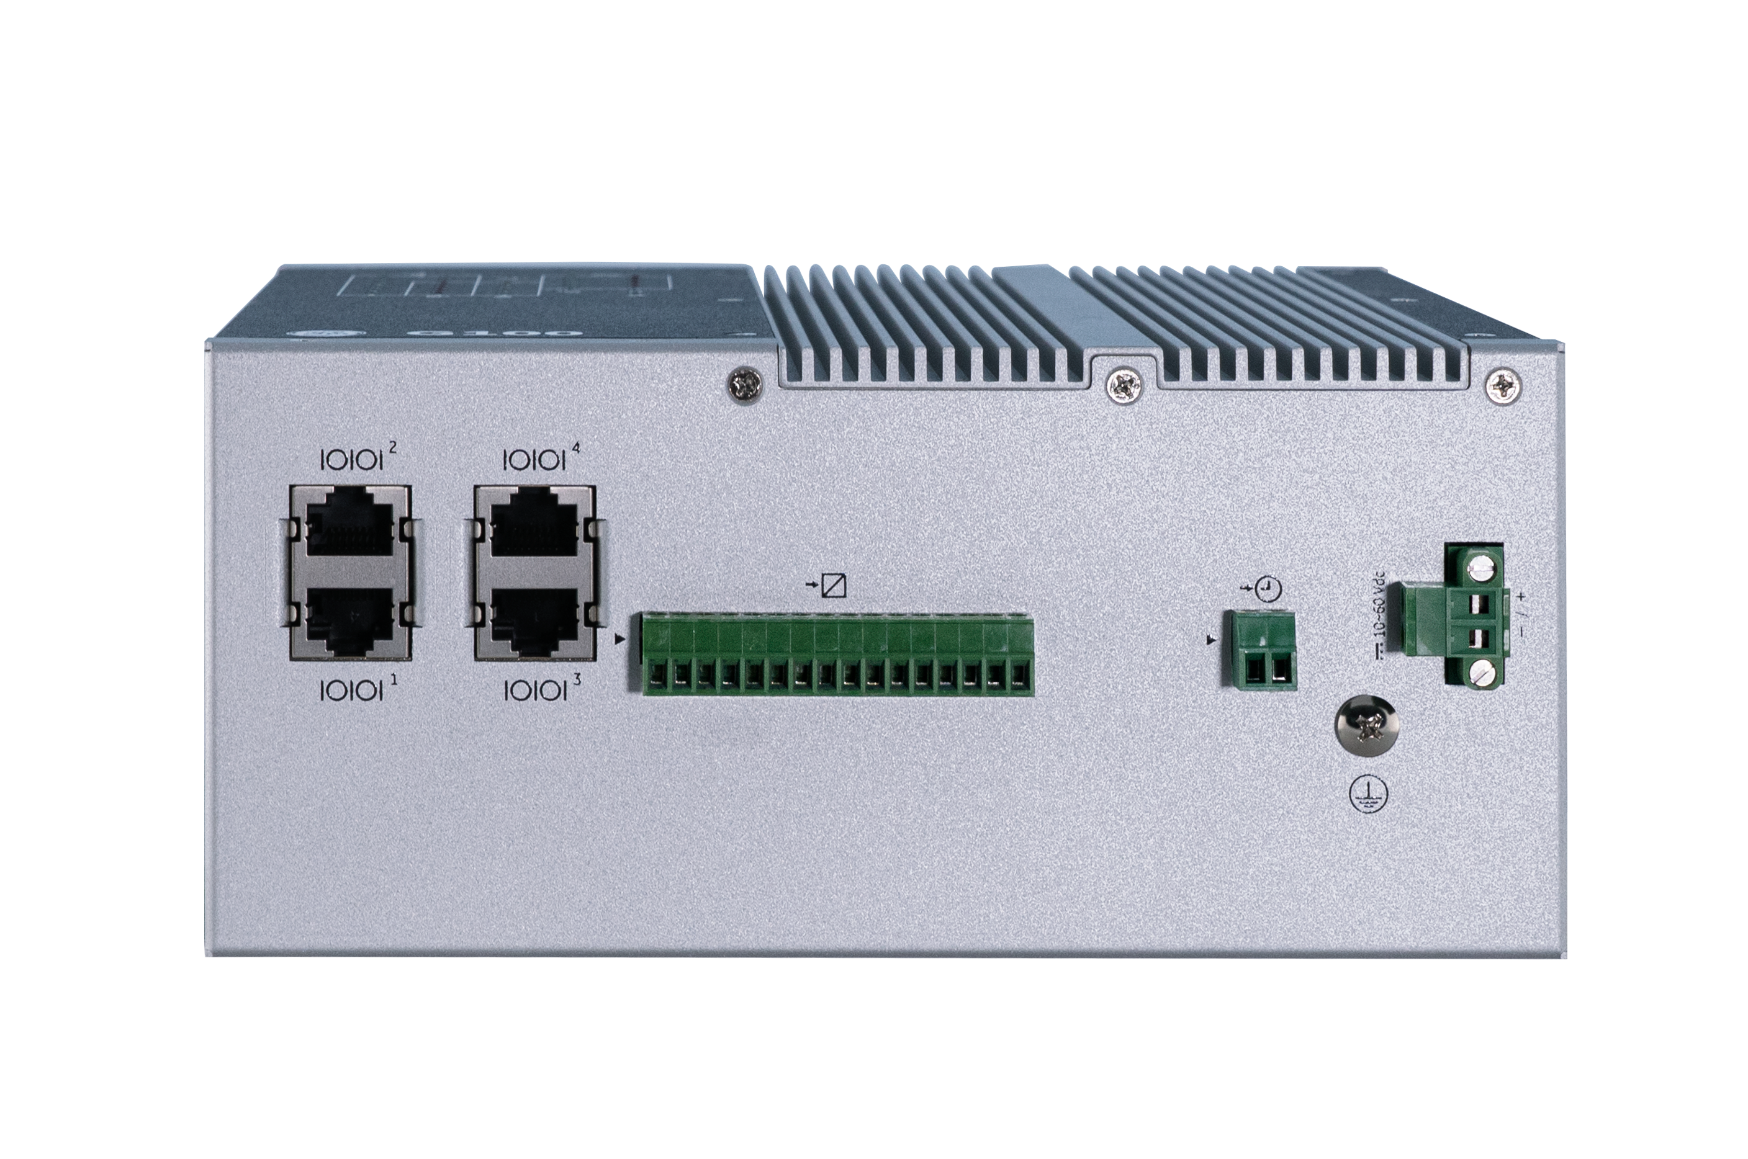
Physical Views
Front View
Top View
Front view
Back View
Bottom view
Front view
Back View
Bottom view
Bottom View
1010 – G100 Hardware
Notes:
As you can see the front view will show you the setup with all the LEDs for easy viewing. The top and bottom views will allow you to see all your connectors for your automation application.

Slide 5
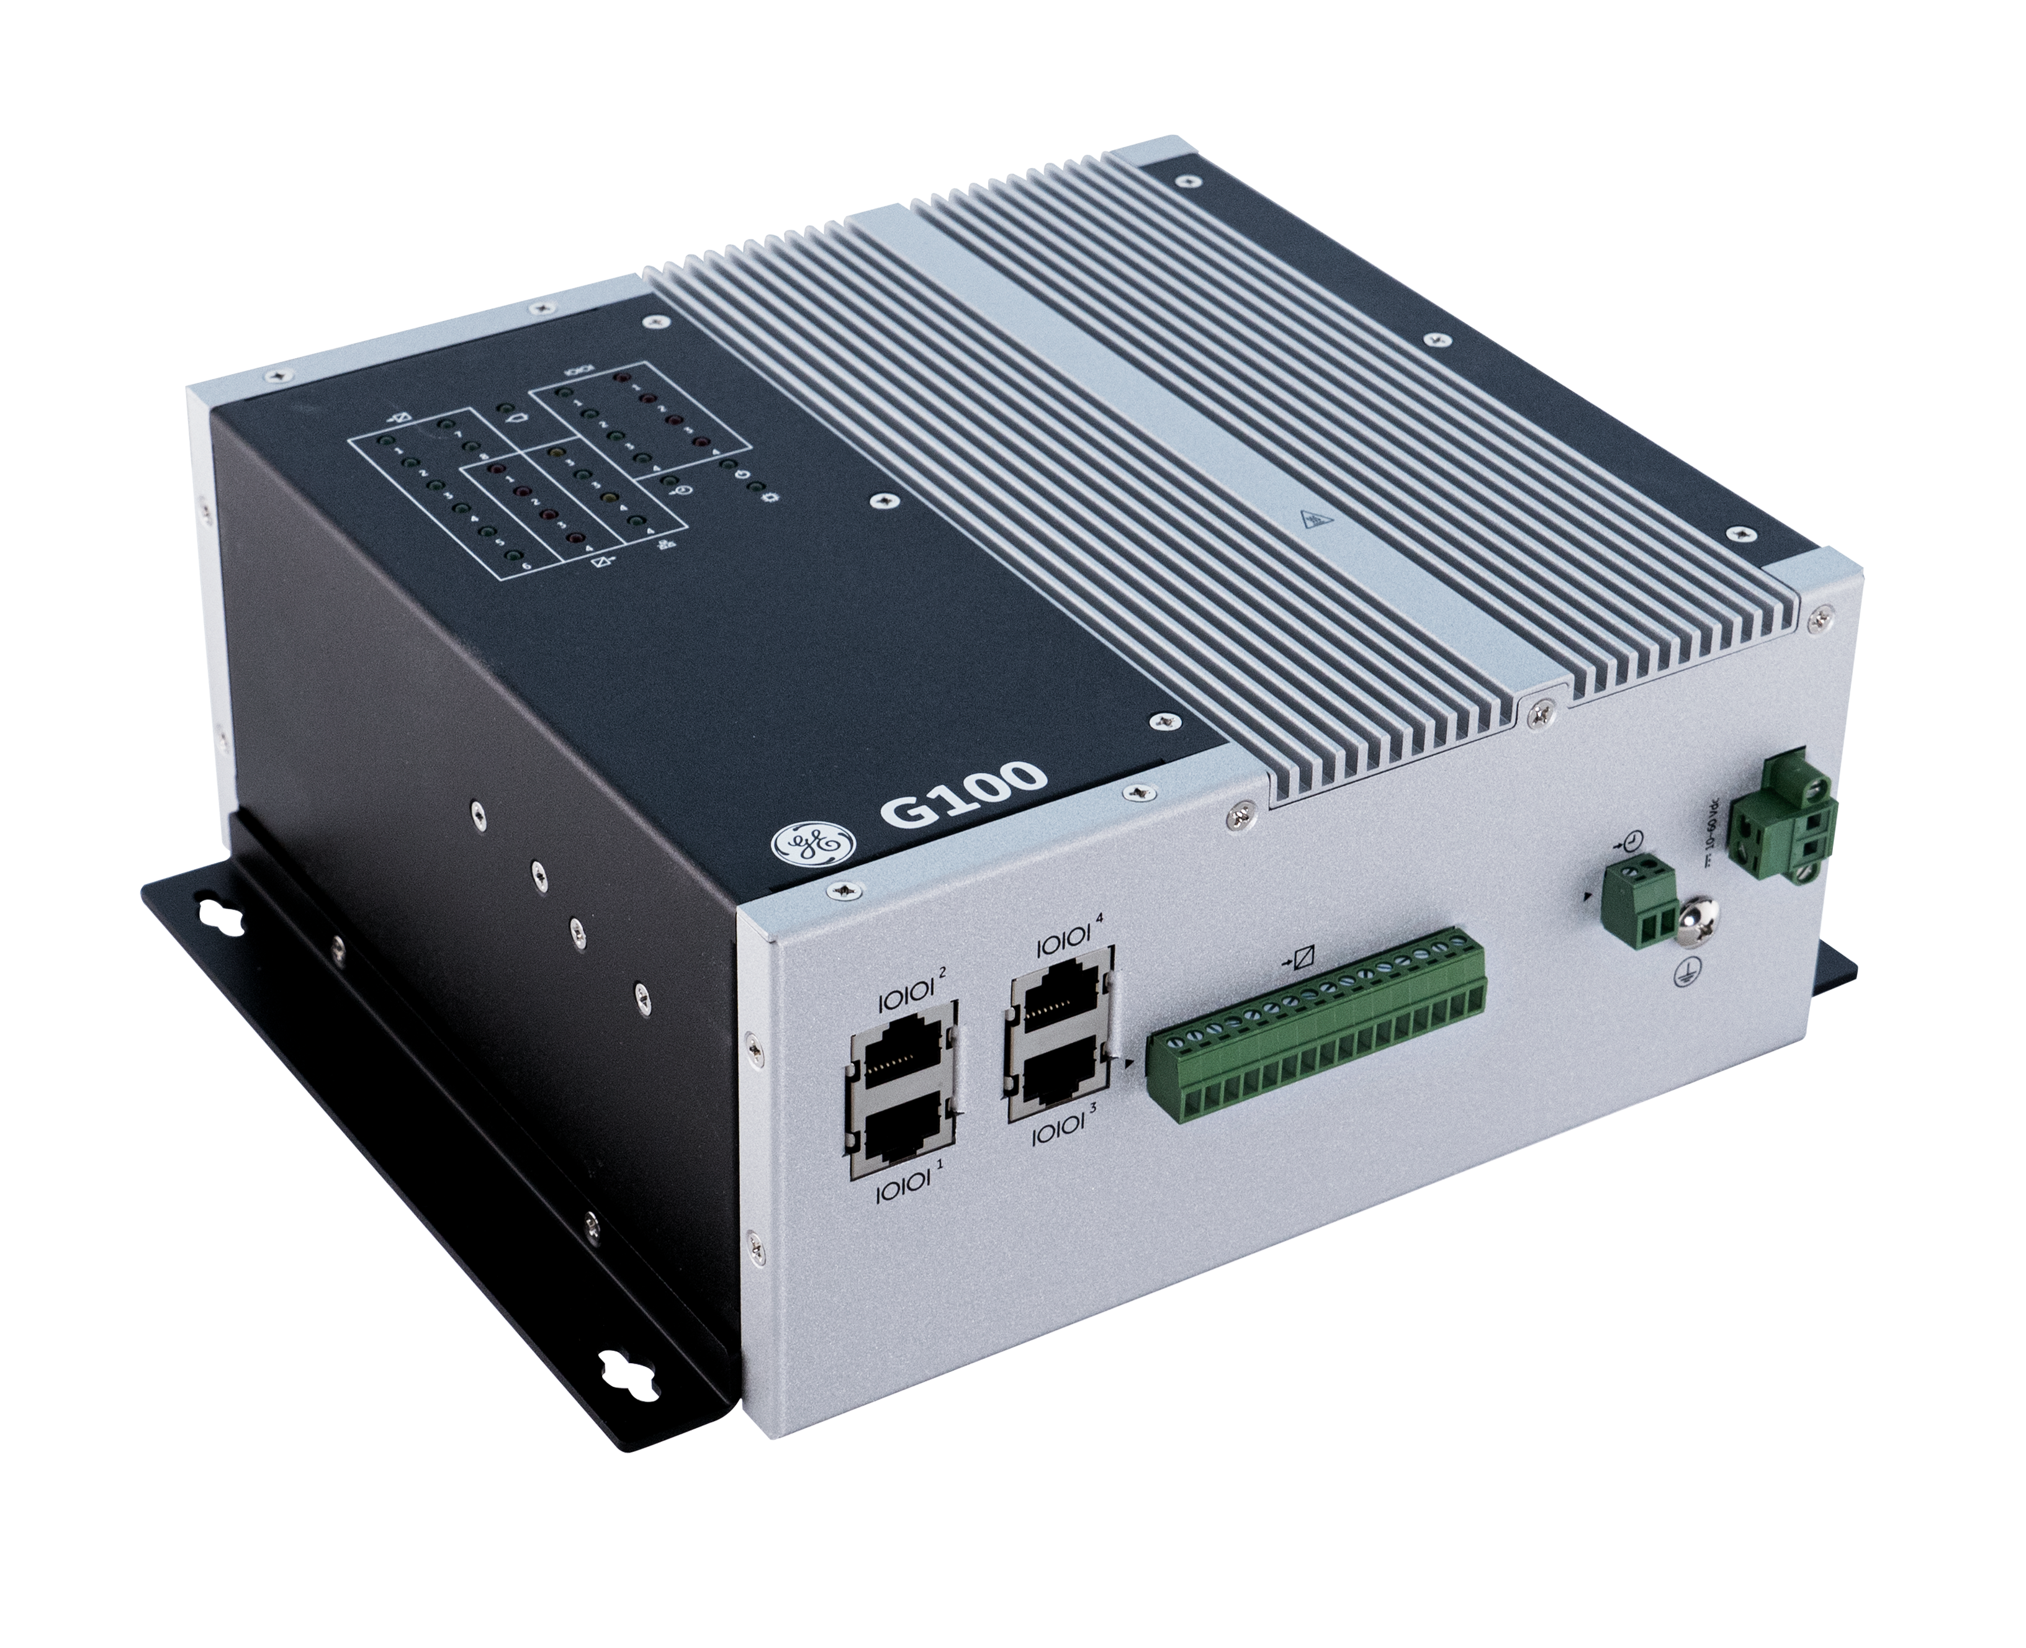
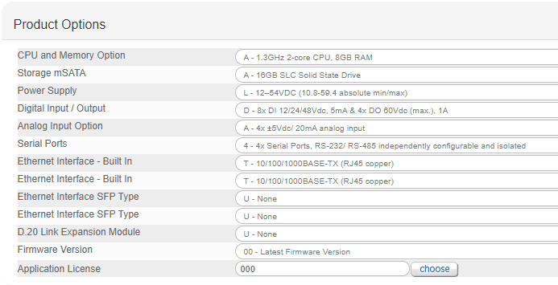
Hardware Options
CPU:
Intel Atom CPU, up to 1.3 GHz
Memory, Storage:
8 GB RAM, 16 GB SSD (80 GB future option)
Operating Temperature:
-40°C~70°C continuous run
HW Compliance:
IEC 61850-3, IEEE 1613,
CE Mark, UKCA, UL, WEEE, REACH, RoHS
Mounting Options:
Panel Mount
DIN Rail Mount
1.3 GHz CPU
8 GB RAM
Panel and DIN rail mount
1010 – G100 Hardware
Notes:
For high voltage DC input or AC input installations an external power supply with 12 to 48VDC output must be connected to the power input terminal.

Slide 6
G100 Dimensions
Width 90 mm
Height 195 mm
Length 200 mm
Weight 2.47 Kg (5.445 lbs.)
Width 90 mm
Height 195 mm
Length 200 mm
Weight 2.47 Kg (5.445 lbs.)
90 mm
3.5 in
195 mm
7.7 in
200 mm
7.9 in
1010 - G100 Hardware
Notes:
Here you can see the width, height and length of the G100 and you can also refer to the instruction manual for any updated dimension specifications.

Slide 7
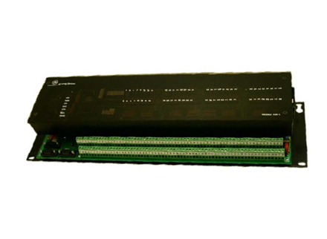
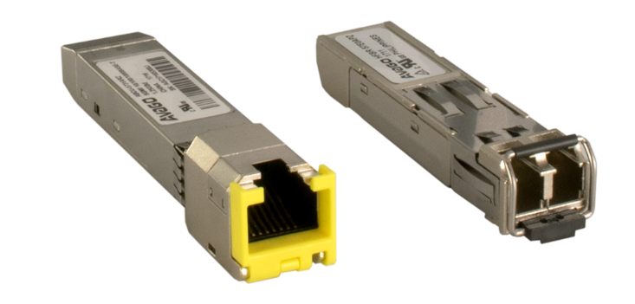
G100 Communications: Data Concentrator, Protocol Converter
D.20 HDLC Card (Optional)
Natively communicate with the same I/O Modules as the D20
D.20 A – DC Analogs
D.20 C – Combo DI/DO/AI/AO
D.20 K – Controls
D.20 S – Status Inputs
4 Ethernet Ports
2 x 10/100/1000 Copper RJ45
2 SFP:
C - 100 Base-TX RJ45
T - 1000 Base-TX RJ45
F - 100 Base-FX LC Fiber (multimode)
S - 1000 Base-SX LC Fiber (multimode)
L - 1000 Base-LX LC Fiber (singlemode)
Individual interfaces
D.20 peripheral support
4 Ethernet ports support
IRIG-B input
4 Serial ports
4 USB ports
Top
4 Serial ports
RS-232 / RS-485 2-wire
SW configurable
RJ45 connectors
(Firmware also supports Virtual Serial Ports)
COM4 is by default a serial console port.
(Can be reassigned to be a general-purpose Serial Port)
IRIG-B Input
TIA 232 or 5V TTL Input
Signal is replicated onto serial ports, if present
1010 - G100 Hardware
Notes:
G100 can be equipped with an optional d.20 hdlc card that supports the d.20 askc to allow you to upgrade from one of our existing legacy gateways like the D20ME for example and replace it with a G100 and retain support for the existing IO cards in your substation. It also comes with 4 serial ports, rs232 and rs485 two wires setup while the comm ports are by default a serial console port. It also comes with 4 ethernet ports with many options on the SFP and also an IRIG-b input to sync the time from an irig=b source.
G100 does not support PTP IEEE1588.
NTP and SNTP are supported.
has 4 USB ports, …2x USB-A 2.0, 1x USB-A 3.0 and 1x USB-C for future use

Slide 8
G100 -Low Voltage unit with General Purpose I/O
4 Analog DC Inputs
+5Vdc / 20mA
12-bit plus sign, self-calibrating
Each AI channel is configurable via internal jumper as Full Scale either +5 Vdc or 20mA
8 Binary Inputs
12/24/48Vdc, 5mA, isolated
All DI are wetted internally from main power supply circuit using single common for all 8 channels.
4 Binary Outputs
Max 60Vdc, 1A
Each DO is isolated and independent, providing a Normally Open dry relay single contact.
4 Analog DC inputs
4 Binary outputs
8 Binary inputs
Single low voltage: 12/24/48 Vdc
Single, Fixed, Low Voltage Power Input rated: 12/24/48 Vdc
For HVDC or AC power inputs, an external power supply or converter is required
1010 - G100 Hardware
Notes:
The G100 is a general purpose unit with a low voltage IO. It has 4 analog dc inputs with a plus 5 volts dc 20ma 12 bit plus sign self calibrating analogue inputs. Each AI channel is configurable via an internal jumper as Full Scale, either +5 Vdc or 20mA. You have 8 binary inputs, 12, 24 and 48vdc with a 5ma isolated setup. You also have 4 binary outputs with a max of 60 volts dc and 1amp. Each DO is isolated and independent. A single fixed low voltage power input rated at 12, 24 and 48 volts dc and for hvdc or ac power inputs, an external power supply or converter is required.

Slide 9
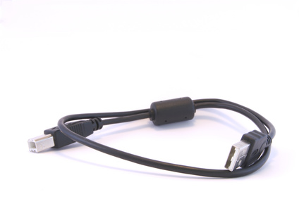
G100 Local Access
1 DisplayPort™
Supports one monitor for Local HMI
Serial Console port
COM4 is by default a serial console port.
Can be reassigned to be a general-purpose Serial port.
One Display Port
USB ports
Serial Console (COM4)
USB Ports:
2 USB-A 2.0 ports
1 USB-A 3.0 port
1 USB-C port for future use
One Display Port
USB ports
Serial Console (COM4)
1010 - G100 Hardware
Notes:
The g100 comes with a display port and supports one monitor for the local HMI. It has 2 usb-a 2.0 ports, 1 usb-a 3.0 port and 1 usb-c port for future use. It also comes with a serial console port which is by default COM4.
Multi Stream Transport (MST) for multiple attached displays is not supported
G100 doesn't support Touch Screen Panel controls due to the absence of external vendor USB drivers. It’s recommended to use a Windows Panel PC and the Remote HMI application instead.

Slide 10
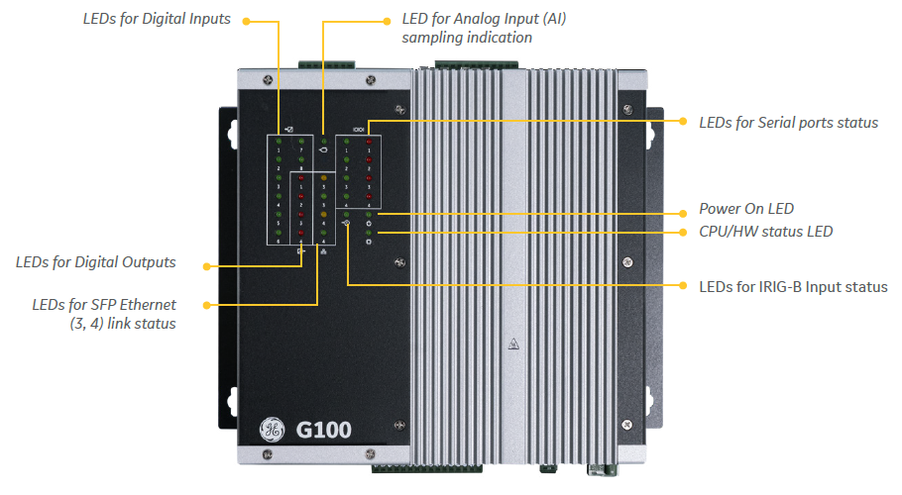
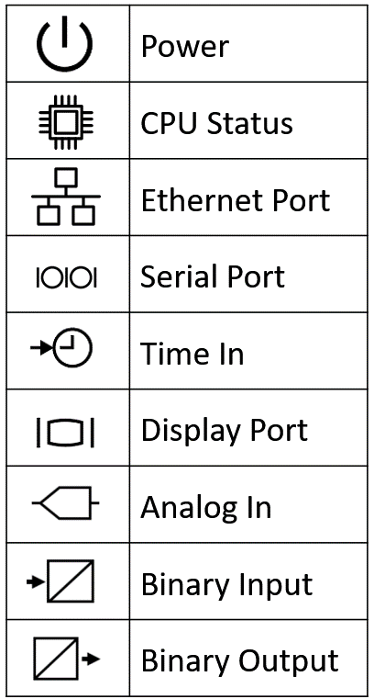
G100 LEDs
Indicators for :
Binary inputs
Binary outputs
Analog inputs
Serial ports
Power on
CPU
IRIG-B
Ethernet
Indicators for :
Binary inputs
Binary outputs
Analog inputs
Serial ports
Power on
CPU
IRIG-B
Ethernet
1010 - G100 Hardware
Notes:
G100 uses display leds for digital inputs, analogue inputs, digital outputs and the activity on the sfp an the serial ports IO, at the same time it will provide the power and cpu status LED with irig-b or time indicator and the display port LED.
For TP Ethernet ports, each RJ45 port has LED indicators inside the RJ45 connector.

Slide 11
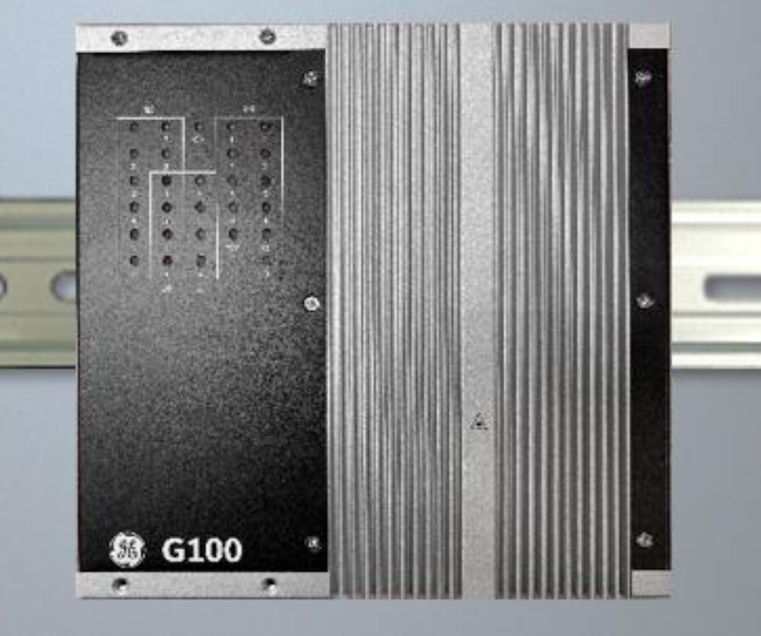
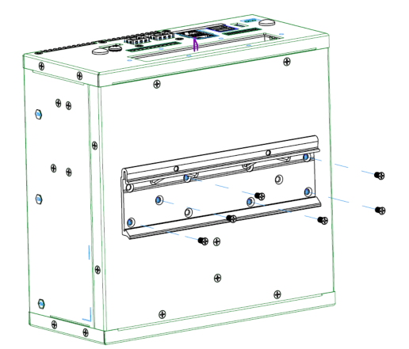
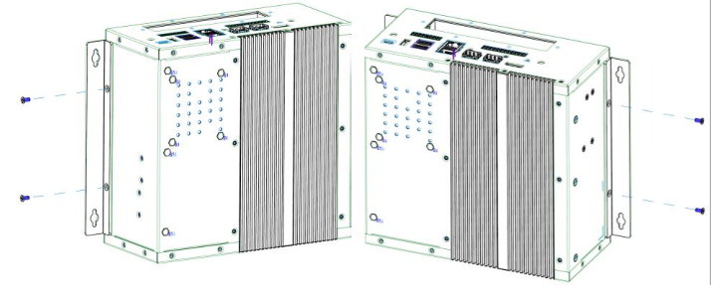
G100 Mounting
Mounting :
Panel mount
Din rail
1010 - G100 Hardware
Notes:
G100 din mounting, when you unpack you have these mounting rails.(keep them safe to make sure it can be utilized when needed).

Slide 12
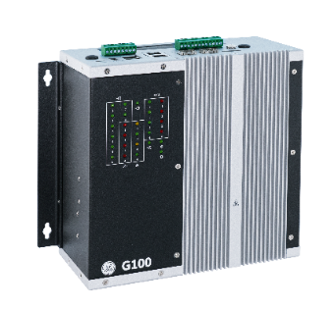
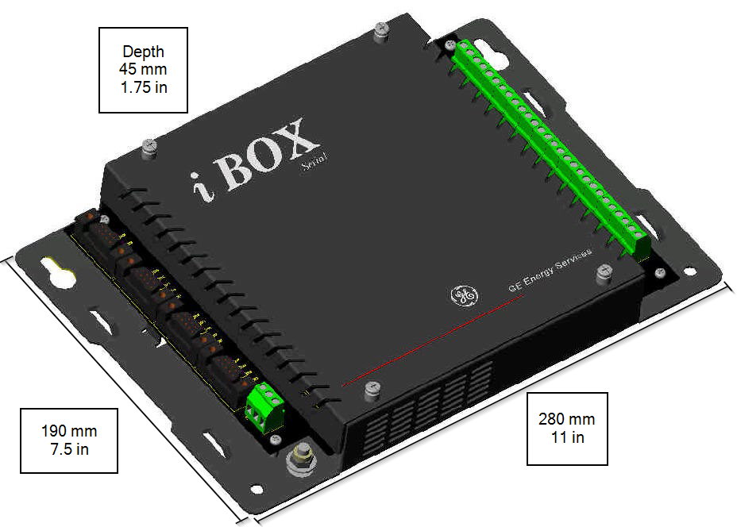
G100 - Easy hardware migration path
Depth
90 mm
3.5 in
Hardware upgrade :
iBox to G100
Hardware upgrade :
iBox to G100
iBox retrofit with G100
195 mm
7.7 in
280 mm
11 in
1010 - G100 Hardware

Slide 13
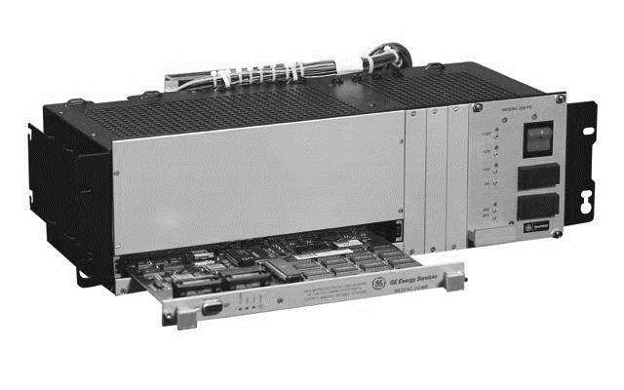
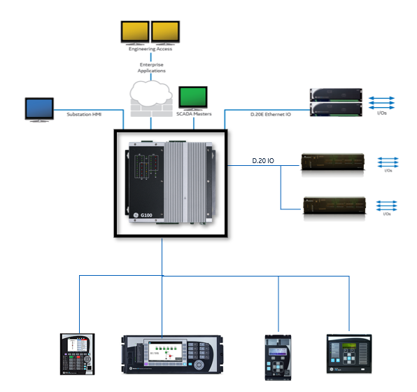
G100 – Easy Hardware Migration Path
Depth
90 mm
3.5 in
Hardware upgrade :
D2x with small point count can be upgraded to G100.
Hardware upgrade :
D2x with small point count can be upgraded to G100.
Small D2x retrofit with G100
195 mm
7.7 in
280 mm
11 in
1010 - G100 Hardware
Notes:
You will need hdlc card added to your hardware configuration.

Slide 14
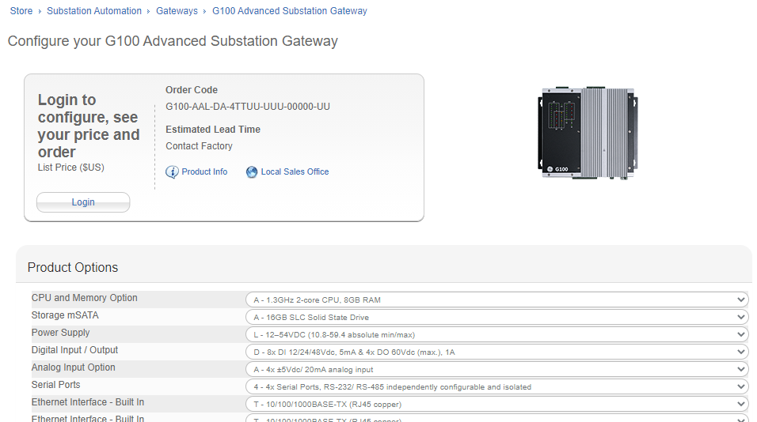
Order G100
Online Store
Documents, Software
Sign Up for Notifications
GE Grid Solutions - Substation Automation Markham Technical Support Web Library | Powered by Box
https://www.gegridsolutions.com/multilin/catalog/g100.htm
https://store.gegridsolutions.com/ViewProduct.aspx?Model=G100
GE Grid Solutions - Substation Automation Markham Technical Support Web Library | Powered by Box
https://www.gegridsolutions.com/multilin/catalog/g100.htm
https://store.gegridsolutions.com/ViewProduct.aspx?Model=G100
1010 - G100 Hardware

Slide 15
Thank you for having watched this educational material

Slide 16
Thank you for having watched this educational material

