Slide 1
1070 – H500 Hardware
Learning & Development
Learning Module
REV A
H500-1070 l H500 Hardware v1
SME Source Markham

Slide 2
Learning & Development
Objective
Learning Module Objective
At the completion of this module you will be able to identify and recite all concepts presented.
If you are viewing this as part of a structured training program PLEASE complete the associated assessment test. You are required to score above 80%.
Learning Module Objective
H500-1070 l H500 Hardware v1
SME Source Markham

Slide 3
H500
Advanced Gateway
Data collection from substation IEDs, for control & secure monitoring
Substation HMI Computer
Central Authentication Server
Security Key Distribution and Management Center
Engineering Workstation
Hardened Substation Automation computer
Rugged Industrial Automation Computer
Advanced Automation
Automate substation procedures using IEC 61131 compliant tools
Secure Remote Access
Securely access substation device locally and remotely
Fault Recording & Data Logging , File Retrieval
Extract valuable data such as digital fault records and event files
GE’s Multilin H500 is a member of the advanced Multi-function Controller Platform (MCP), which offers a high-capacity set of modular and scalable hardware and software components, designed to simplify deployment, operation, and maintenance of automation systems for a variety of applications.
H500 l Hardware
Notes:
GE’s Multilin H500 is a member of the advanced Multi-function Controller Platform (MCP). This platform offers a high-capacity, secure, future-proof, and substation-hardened set of modular and scalable hardware running Windows 10 IoT LTSB Operating System

Slide 4
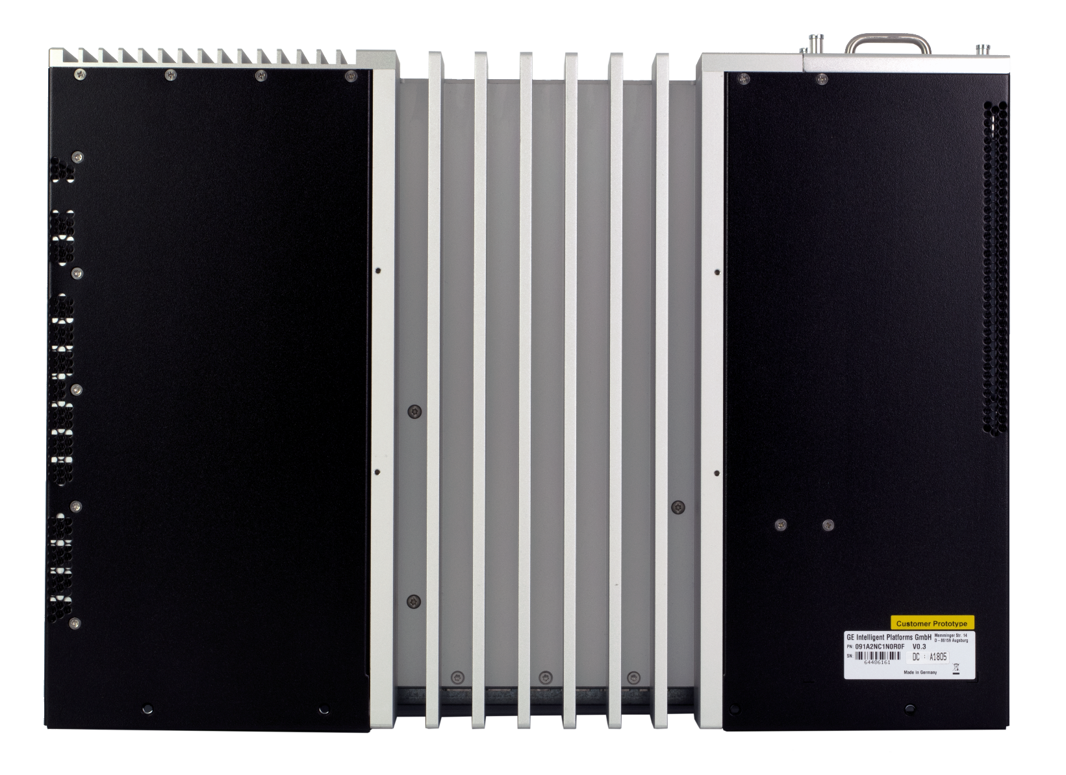
Physical views
Front View
Side View
Front view
Back View
Top view
Side view
Front view
Back View
Top view
Side view
Top View
Rear View
Notes:
The formfactor of the H500 front and back was designed for intuitive connections and indicators were placed to provide and support operators and installers during their tasks.

Slide 5
SD Slot
SD Slot
SD, SDHC and SDXC
Push-pull
Logs
Drive activity indicator
SD, SDHC and SDXC SD Cards
Potential for data log files
Push-pull mechanism
Advantage of SD over micro-SD is lack of ejection spring
1070 – H500 Hardware
Notes:
H500 is equipped with SD slot. There is front indicators for drive, serial and network activity. Another set of LEDS to indicate access of SSD.

Slide 6
USB – Universal Serial Bus
Front and rear USB type A ports (6)
Front two USB 3.0 type A ports
Rear four USB 2.0 type A ports
Notes:
H500 at the front there is 2 USB 3.0 type A, and a type B, also there is 4 USB 2.0 connectors at the back.

Slide 7
Local HMI Monitor display connectors
Up to two monitors per port via MST
Note : H500 was designed with DP has mechanical latching while HDMI doesn’t have this capability.
Rear Two DisplayPort video interfaces
Display Port (DP) Version 1.2 and DP++ compliant
Up to 2 monitors per port via MST
Up to UHD (4k, 3840x2160) for single display
Up to QHD (2560x1440) for multi-stream connected displays
1070 – H500 Hardware
Notes:
H500 has support for two HMI dp compliant ports.

Slide 8
Order H500
Online Store
Documents, Software
Sign Up for Notifications
GE Grid Solutions - Substation Automation Markham Technical Support Web Library | Powered by Box
https://www.gegridsolutions.com/multilin/catalog/H500.htm
https://store.gegridsolutions.com/ViewProduct.aspx?Model=H500
GE Grid Solutions - Substation Automation Markham Technical Support Web Library | Powered by Box
https://www.gegridsolutions.com/multilin/catalog/H500.htm
https://store.gegridsolutions.com/ViewProduct.aspx?Model=H500
Notes:
This was a brief description of the H500 platform please feel free to visit our online resources to download manuals and access more support. We look forward to seeing you in future trainings.

Slide 9
Thank you for having watched this educational material

Slide 10
Thank you for having watched this educational material

