Slide 1
2010 – G100 INITIAL SETUP
Learning & Development
Learning Module
REV A
G100 substation
automation
G100-2010 l G100 Initial Setup v1
SME Source Markham

Slide 2
Learning & Development
Objective
Learning Module Objective
At the completion of this module you will be able to identify and recite all concepts presented.
If you are viewing this as part of a structured training program PLEASE complete the associated assessment test. You are required to score above 80%.
Learning Module Objective
G100-2010 l G100 Initial Setup v1
SME Source Markham

Slide 3
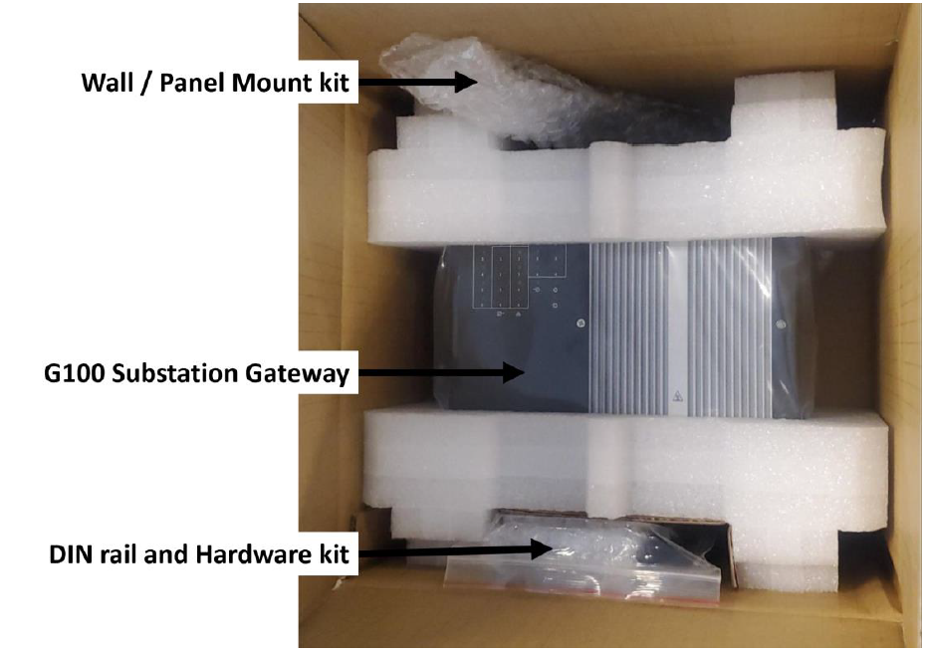
What’s in the Box?
Your kit includes the following:
G100 Substation Gateway
Wall / Panel mount kit
Wall / panel mounting bracket (quantity 2)
DIN rail and hardware kit
DIN Rail (quantity 1)
Screws (quantity 6)
Analog DC Input (AI) connector (quantity 1)
Binary Input (DI) connector (quantity 1)
Binary Output (DO) connector (quantity 1)
Power input connector (quantity 1)
IRIG-B input connector (quantity 1)
Documentation:
Refer to SWM0116 G100 Substation Gateway Quick Start Guide
G100 l What’s in the Box
2010 – G100 INITIAL SETUP
Notes:
After unpacking the G100 box, your first step should be to inspect it for visible damage that could have occurred during shipping or unpacking. If damage is observed, usually in the form of bent component leads or loose socketed components, contact GE Technical Support for additional instructions. Depending on the severity of the damage, it may be necessary to return the product to the factory for repair.
You kit will include the: G100 Substation Gateway, Wall / Panel mount kit, DIN rail and hardware kit and some connectors

Slide 4
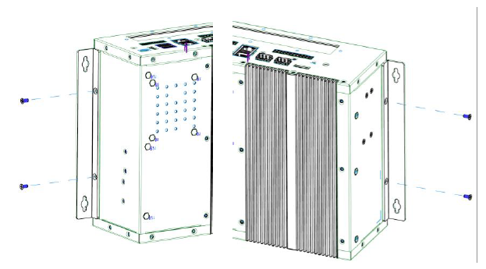
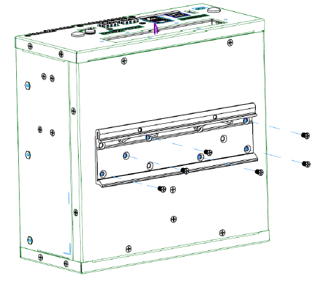
Wall/Panel Mount Kit
Includes 2 wall/panel mount bracket.
They can be optionally attached to the G100 chassis for mounting the G100 to a wall or panel.
The brackets are attached to the G100 chassis using the 2 lower M3 screws on the left and right side of the chassis.
DIN Rail and Hardware Kit
Includes a DIN rail bracket along with 6 mounting screws.
The DIN rail bracket can be optionally attached to the back of the G100 chassis for DIN rail mounting applications.
Notes:
The G100 device can be installed as either wall / panel mounted, or DIN Rail mount.
Here is a brief overview on the installation steps and what is included in your hardware kit
Refer to (994-0155) Multilin G100 Substation Gateway Instruction Manual for more details on full installation procedure
The G100 shall be installed in:
• Pollution Degree II, non-hazardous and restricted access location,
• Environment where the ambient temperature does not exceed the rating of the product,
• Air flow is not restricted.

Slide 5
G100 Top Panel
The top panel provides access to:
1x DP display port
2x TP Ethernet ports with LED indications (labelled 1, 2)
2x SFP Ethernet ports (labelled 3, 4)
2x USB2 ports
1x USB3 port
1x USB-C port (future, currently not used)
4x Analog Input (AI) connections (12 pin connector)
4x Binary Output (DO) connections (8 pin connector)
D.20 HDLC connections, with LED indications (optional, in PCIe slot)
G100-2010 l Top Panel
Notes:
This slide is an overview of the G100 Top Panel.
G100 is equipped with an internal general purpose Input/ Output Interface(GPIO) indicated by numbers 7 and 8 in the figure.
G100 can communicate with D20 peripheral modules. To communicate with D20 peripheral I/O modules the G100 requires the installation and configuration of the optional D.20 HDLC PCIe card indicated by the number 9 in the figure
Refer to (994-0155) Multilin G100 Substation Gateway Instruction Manual for more details

Slide 6
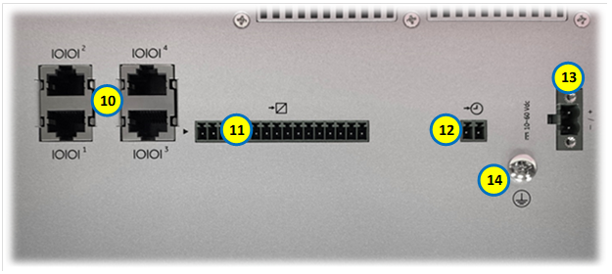
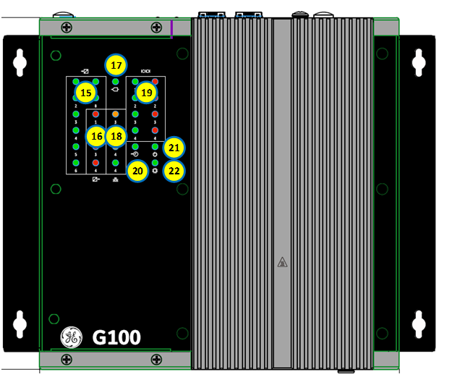
G100 Bottom Panel
The bottom panel of the G100 provides access to:
4x Serial ports (RS232/485, RJ45, labelled 1-4)
8x Binary Input (DI) connections (16 pin connector)
Time synchronization input with IRIG-B TTL input (2 pin connector)
Power Supply connection (2 pin connector)
Protective Earth (PE) Ground connection (screw)
G100 Front Panel
The front panel of the G100 provides the following LED indications:
8x LED for Binary Input (DI)
4x LED for Binary Output (DO)
LED for Analog Input (AI) sampling indication
SFP Ethernet (3, 4) link status LED
4x Serial ports status LED
IRIG-B Input status LED
Power On LED
CPU/HW status LED, is ON when the unit operates normally
G100-2010 l Bottom-Front Panel
Notes:
This slide talks about the G100 bottom and front panel views.
Number 11 on the G100 Bottom panel is for the GPIO DI connections
The LED’s marked as 15,16,17 on the Front Panel are the GPIO DI Channel/ DO Channel/ AI sampling indications at runtime.
Number 19 - Each serial port has LED activity (Tx/Rx) indicators on the front panel:
• Tx Activity (Green)
• Rx Activity (Red
Number 18 - Each SFP port has LED indicators on the front panel:
• Activity (Green)
• Link (Orange)
Check Number – 21 Power on LED for successful power up

Slide 7
G100 Redundancy
A redundant G100 setup allows a secondary G100 to automatically take over operations from a paired G100 unit that has failed
To implement a redundant G100 system, you need the following components:
Component | Function | GE part number
RS232 Switch Panel | Communications switch | 517-0247
Power Supply | Power supply to power the RS232 switch panel. Input: 85 – 264 VAC or 90 – 350 VDC. | 580-0046
G100 RJ45 to RS232 Serial Cable | Connects the G100 to the RS232 switch panel which is then connected to external field devices. | 977-0556/LLL
Watchdog Cable Assembly | Connects G100 A to the RS232 switch panel. | 977-0568/LLL
 | Connects G100 B to the RS232 switch panel. | 977-0568/LLL
Ping Cable Assembly | Links both G100 units to facilitate a heartbeat message that determines the status of the active unit. | 977-0559/LLL
G100 A/B RS232 Switch panel Jumper (P1/P9) | Connects the isolates common of serial port to the signal used in switch panel so G100 (A or B) can make itself the active unit. | 977-0562
Power Cable | Connects the RS232 switch panel to an external power supply. | 970-0161
Ground Cable | Provides a ground connection for the RS232 switch panel. | 970-0182
(/LLL) is length of the cable in inches, i.e. 36inches is /036.
G100-2010 l Redundancy
Notes:
G100 system redundancy is available starting with Firmware version 3.00.
G100 redundancy requires two identical model and configuration G100 units and zero, one, or two RS232 switch panels when connecting to RS232 devices. RS232 switch panels are not required when connecting to RS-485 devices.
A redundant G100 setup allows a secondary G100 to automatically take over operations from a paired G100 unit that has failed.
As you can see here is different components needed to implement G100 redundancy
Refer to G100 Substation Gateway Instruction Manual for more details on Redundancy wiring and configuration

Slide 8
Product Documentation
MCP Product Documentation Set:
Includes all available documents for both G500 and G100
MCP Software Configuration Guide:
Provides detailed information on how to configure the MCP software
Quick Start Guide:
SWM0116 G100 Substation Gateway Quick Start Guide
Instruction Manual:
994-0155 G100 Substation Gateway Instruction Manual
Technical Support Library:
GE Grid Solutions - Substation Automation Markham Technical Support Web Library | Powered by Box
G100-2010 l Production Documentary
Notes:
Here are some key documents available and The Technical Support Library point you to the documentation and support repository.
The link takes you to the Tech Support page where you can select the G100 Substation Gateway, RTU and Controller folder. You can select the desired firmware version folder to see the list of available documents and support resources

Slide 9
G100 Release Notes
Outline key features, capabilities, and known issues within the MCP at the time of release.
Technical Support Library:
GE Grid Solutions - Substation Automation Markham Technical Support Web Library | Powered by Box
Product Website:
https://www.gegridsolutions.com/multilin/catalog/g100.htm
Online Store:
https://store.gegridsolutions.com/ViewProduct.aspx?Model=G100
G100-2010 l Release Notes
Notes:
The Release notes outline key features, capabilities, and known issues within the MCP at the

Slide 10
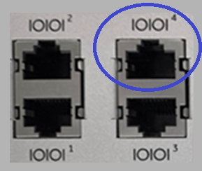
G100 Interface Options
The following connection / interface options are available after G100 first power up:
Local KVM (Keyboard, Video and Mouse) :
Connect the Display Port to a monitor with a display cable.
Connect a keyboard and mouse to any of the USB ports.
2. Default Maintenance Ethernet Port:
Ethernet Port #1
Default IP address: 192.168.168.81
3. Default Serial Maintenance Port:
Serial port # 4 in RS232 mode
Default settings: 115200 baud rate, 8 data bits, no parity and 1 stop bit (abbreviated as 115200 8N1)
Can be disabled
KEYBOARD
KVM
VIDEO
MOUSE
G100-2010 l Interface Options
Notes:
Once the unit is powered up, several interface options are available for connecting to the device. This includes Local KVM, Maintenance Ethernet Port and Serial Maintenance port.
Please refer to the next video on G100 Access to get more information on the connection/interface options.

Slide 11
Thank you for having watched this educational material

Slide 12
Thank you for having watched this educational material

